Slide 1
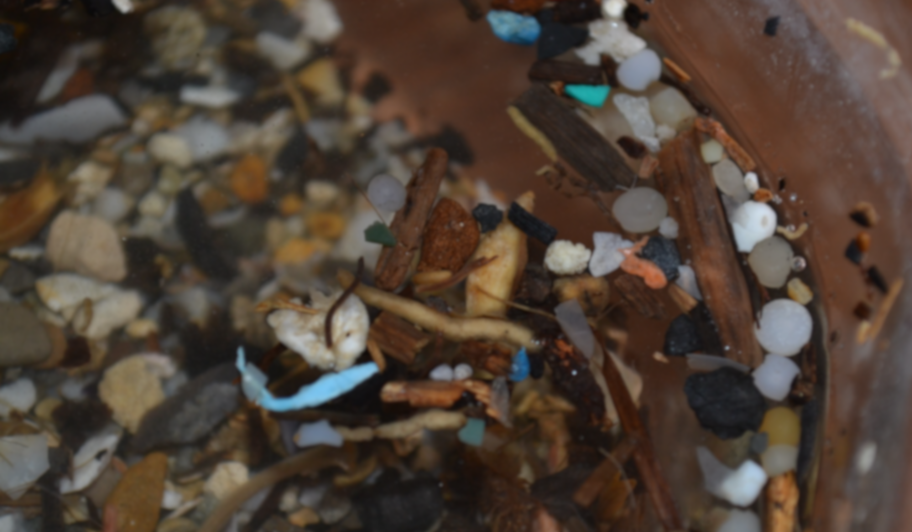
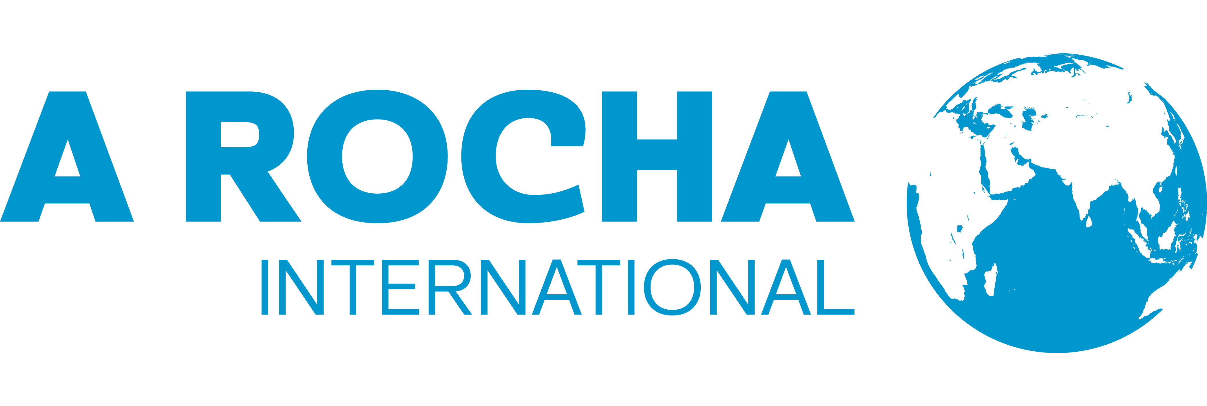
Introduction to Microplastics
Notes:
Version 1.2 – 23 Nov 2023
With thanks for revision and updates to:
Gavin K. Gillmore,
Emeritus Professor of Research,
Bath Spa University

Slide 2
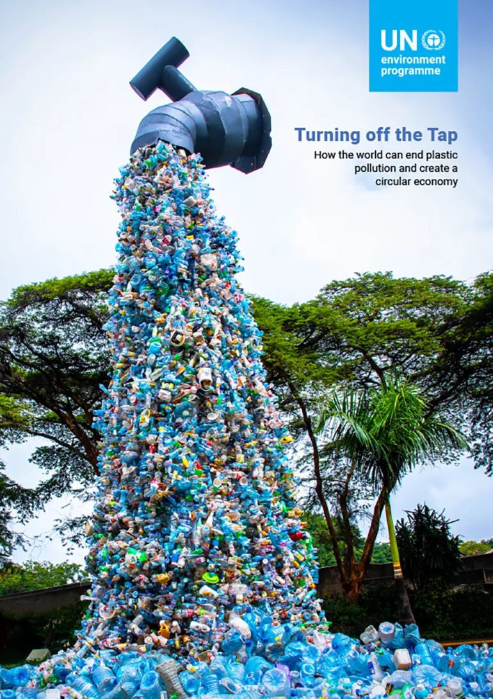
Global Plastics Treaty
430 metric tons of plastic is produced / year (UNDP, 2023) with only 9% recycled
Intergovernmental Negotiating Committee (INC) on Plastic Pollution met in Nairobi, 2023 – mandated by UN Environmental Agency resolution 5/14
More meetings in 2024 to complete negotiations
Focussed on plastics life cycle, product design for food packaging
Do we cap production of primary plastics or focus on pollution?
Notes:
UNDP – United Nations Development Programme.
See https://www.undp.org/blog/global-treaty-end-plastic-pollution-sight

Slide 3
Global Plastics Treaty
Recognizes that plastic pollution includes microplastics
Reaffirms UN General Assembly Sustainable Development goals
Reaffirms the 1992 Rio Declaration on Environment and Development
Recalls United Nations Environment Assembly resolutions on the urgent need to strengthen global coordination
Recognizes the wide range of approaches, sustainable alternatives and technologies available to address the full life cycle of plastics
Notes:
See
UNEA Resolution 5/14 entitled “End plastic pollution: Towards an international legally binding instrument”. UNEP/PP/OEWG/1/INF/1. Resolution adopted by the United Nations Environment Assembly on 2 March 2022.

Slide 4
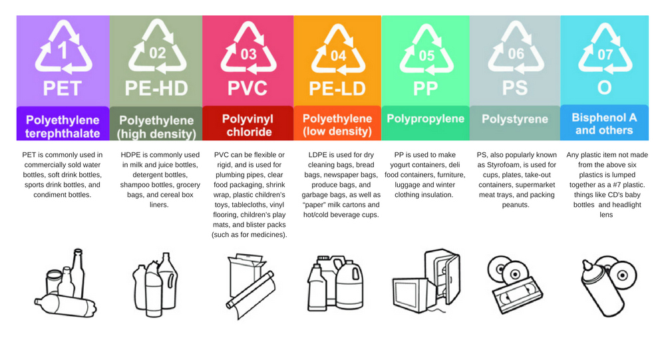
Global Plastics Treaty
NOTE: The large number of types or compositions of plastics makes recycling difficult.
See Greenpeace https://www.verycompostable.com/posts/report-circular-claims-fall-flat/
Accessed 23/02/24
Notes:
See
UNEA Resolution 5/14 entitled “End plastic pollution: Towards an international legally binding instrument”. UNEP/PP/OEWG/1/INF/1. Resolution adopted by the United Nations Environment Assembly on 2 March 2022.

Slide 5
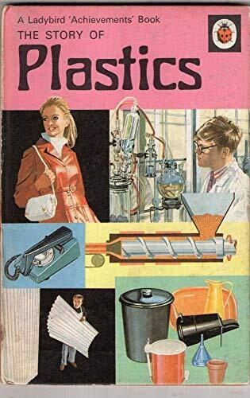
This Ladybird children's book was produced in 1972 when plastics were seen as a great innovation
Plastic production really began in earnest in WW2 with rubber being in short supply and the introduction of synthetic rubber
Such rubber, now in car tyres, forms a major contributor to microplastics in the environment

Slide 6
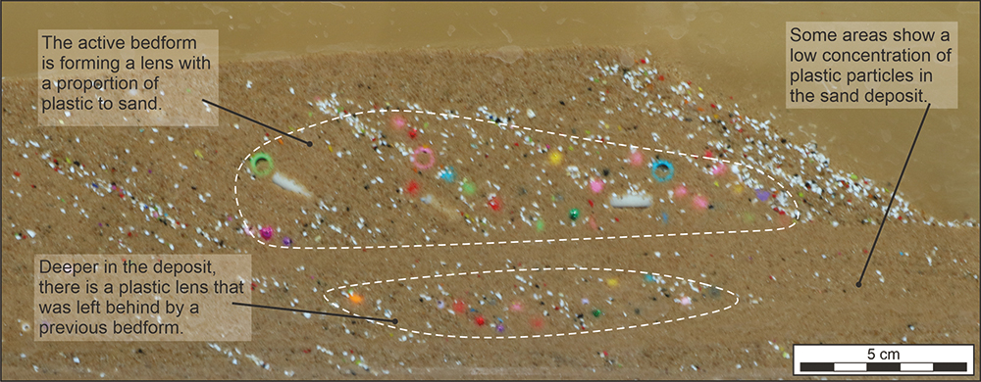
Microplastics in the Environment
Russell, 2023
Microplastics have become so common in the environment they are now impacting on the way in which sediment builds up in rivers – increasing in many cases erosion and transportation of sediment
Notes:
Russell, C., 2023. Sedimentation Shifted: The peculiar process of plastic-riddled riverbeds. Geoscientist, 33 (04), 14-19.

Slide 7
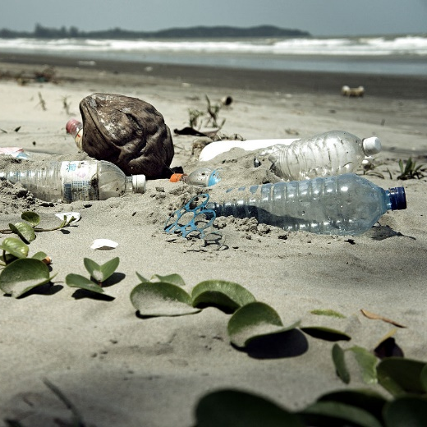
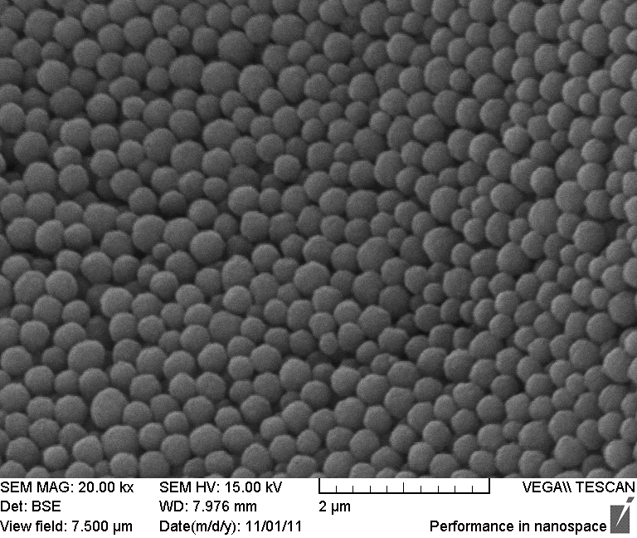
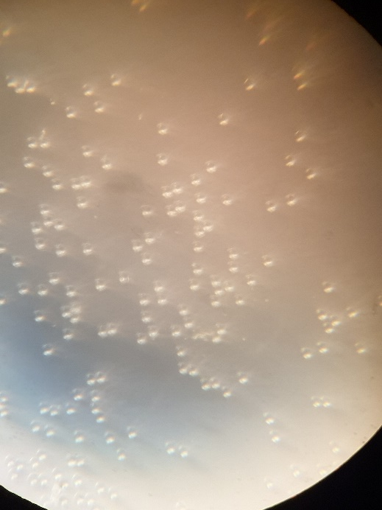
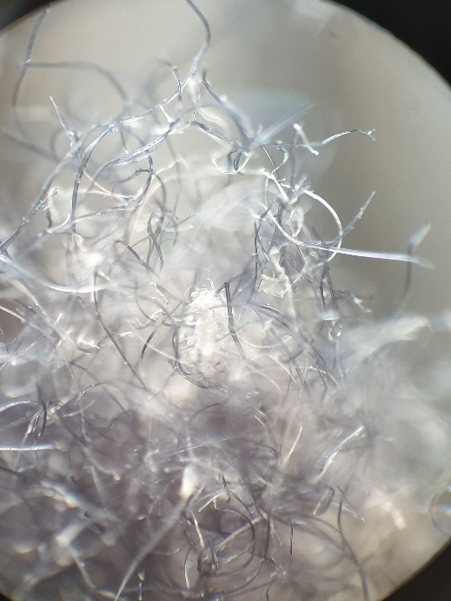
Plastic pollution size categories
Macro
Micro
Nano
$≥$25mm
< 5mm
<1 $μ$m
Light microscope image of polystyrene beads 20-5 $μ$m in size
Polycotton fibres, x70 magnification
SEM image of nanoplastic beads (Murray and Ormeci, 2020)
Notes:
The term Microplastics is differently interpreted in terms of size by different people. Andrady (2011) defines microplastics as 5mm to 50 microns whilst others define micro as between 0.5 and 1 mm in every dimension. Bermudez and Swarzenski (2021) define microplastics as between 200 and 20 microns, classifying larger sizes as macro and mesoplastics. Below this are nano, pico and femto sizes.
References.
Andrady, 2011
Bermudez, J.R., Swarzenski, P.W., 2021. A microplastic size classification scheme aligned with universal plankton survey methods. MethodsX. DOI 10.1016/j.mex.2021.101516.
Murray, A., Ormeci, B., 2020. Removal Effectiveness of Nanoplastics (< 400 nm) with Separation Processes Used for Water and Wastewater Treatment. Water, 12, 635; doi:10.3390/w12030635.

Slide 8
Plastic pollution size categories
There is no standard measurement size for microplastics.
However, where seawater microplastics are concerned it is not uncommon to use zooplankton nets of 200-400 $μ$m net size (Green et al., 2018).
However, bongo nets (>500 $μ$m) and manta nets (>300 $μ$m) have also been used.
Green et al. (2018) argues that this underestimates microplastics and that 1 litre grab sampling is better.
Notes:
Green, D.S., et al., 2018. A comparison of sampling methods for seawater microplastics and a first report of the microplastic litter in coastal waters of Ascension and Falkland Islands. Marine Pollution Bulletin, 137, 695-701.

Slide 9
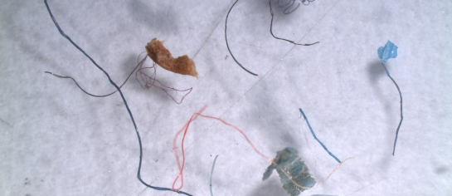
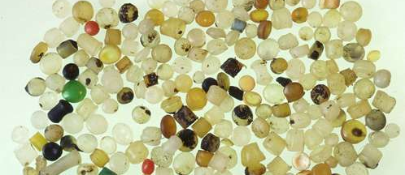
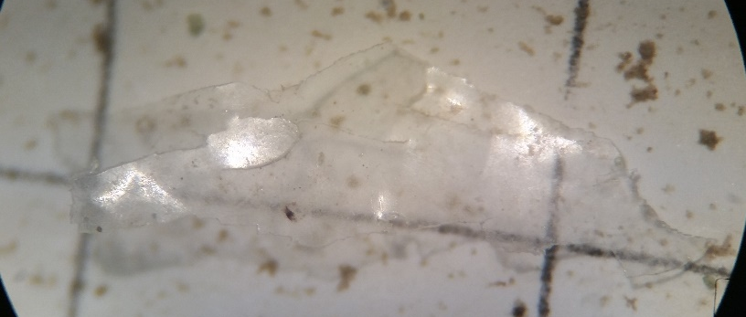
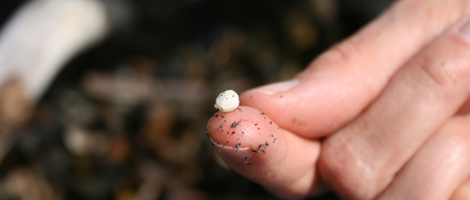
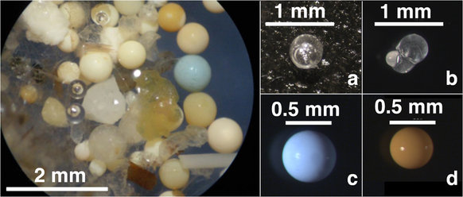
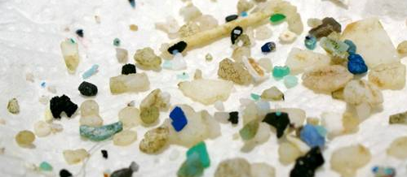
Types of microplastics | Overview
PRIMARY MICROPLASTICS: Those which enter the marine environment in their « micro » size
SECONDARY MICROPLASTICS: Resulting from the breakdown of larger plastics in the marine environment
Fibres
Pellets
Films
Foam
Microbeads
Fragments
Notes:
Microplastics can be divided into two categories: primary and secondary. Primary microplastics are those which enter the environment already in this size category either because they have been manufactured that size (eg. pre-industrial pellets or “nurdles”) or resulting from the abrasion of larger plastic items during manufacturing or use (e.g. clothes fibres released during washing process). 98% of losses of primary microplastics are from land-based activities. Secondary microplastics are those which originate from larger plastic objects degrading in the marine environment through the effect of wind, waves or sunlight, such as fragments, films and foams.
Microbeads, famous for their presence in cosmetics, but also used in sandblasting, are mini-microplastics of the primary kind.

Slide 10
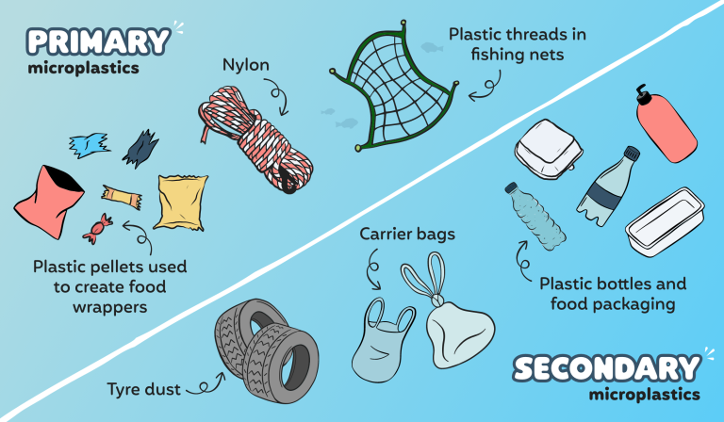
Types of microplastics | Fragments, films and foams
From https://blog.themodernmilkman.co.uk/what-are-microplastics/
Notes:
Large plastics break down in the environment by the action of UV light, wind and waves. Plastics are made to be durable and to resist decomposition. Therefore, this breaking down process undergone in the marine environment doesn’t cause the plastic to disappear it only makes it smaller, and therefore more problematic- we will explain why later in the presentation.

Slide 11
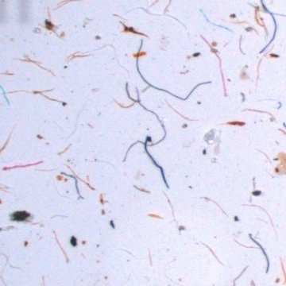
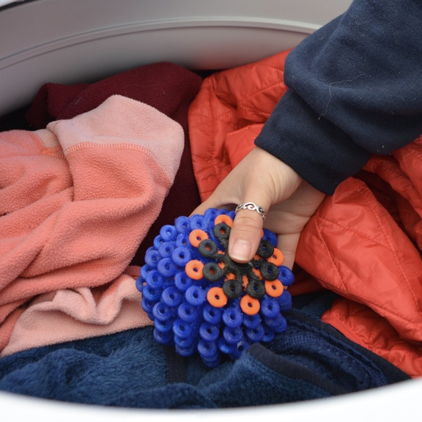
Types of microplastics | Fibres
More and more clothing is being made from synthetic fibres: polyester, polyethylene, nylon, acrylic, elastane.
Fibres can be released from these clothing items during the manufacturing process and also the washing process: most household washing machines are not equipped with filters for the fibres.
Washing a polyester fleece can release nearly 2000 fibres into the marine environment. These are carried in wastewater and discharged into the ocean.
Notes:
More and more clothing is being made from synthetic fibres: polyester, polyethylene, nylon, acrylic, elastane. These are all names you may recognise. Fibres can be released from these clothing items during the manufacturing process and also the washing process: most household washing machines are not equipped with filters for the fibres. Washing a polyester fleece can release nearly 2000 fibres into the marine environment. These are carried in wastewater and discharged into the ocean.
In a recent study of microplastics in the Atlantic ocean, 94% of all microplastics sampled in the sub-surface water column were fibres. (Kanhai et al., 2017)
INTERACTION: In pairs or small groups: can you name the type of fibre of the clothes you are wearing right now?
What can you do about it? Wash clothes less often, use a “coraball” (pictured) to capture the fibres, or Patagonia sells “Guppyfriends” which are bags in which you place your laundry before putting them into the washing machine that capture the fibres, or even install a filter on your washing machine.

Slide 12
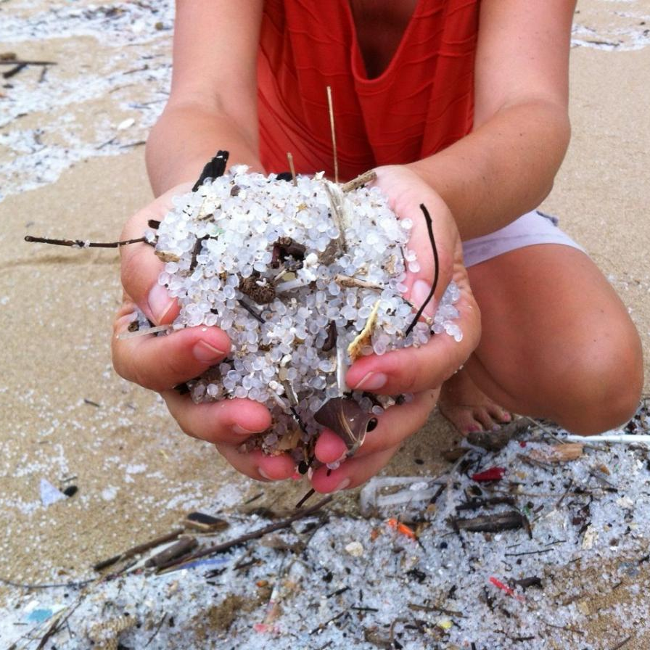
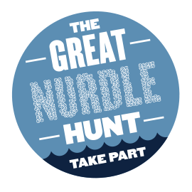
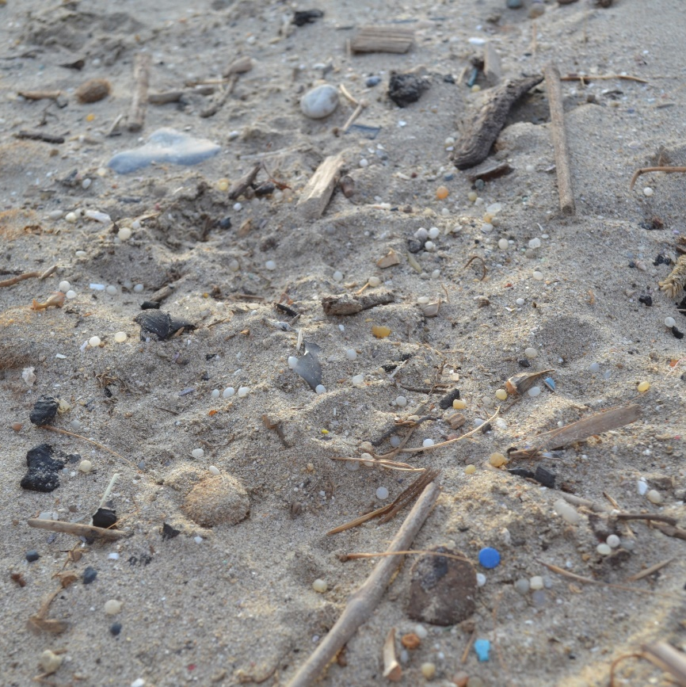
Types of microplastics | Nurdles
Pellets (also known as nurdles) are sometimes spilled into the marine environment during any of the stages from manufacturing, transporting and transforming. They can be found along coastlines and waterways, or floating on the ocean’s surface.
They represent 0.3% of the global release of primary microplastics in the world ocean, and can be released through road runoff, wastewater, and directly into the ocean.
Notes:
Plastic pellets are the form in which plastic is transported between the place that produces the plastic material, and the place that will transform it into the items we see on shop shelves. They are typically between 2-5mm in diameter and shaped like a disk or lentil. They come in a rainbow of colours. Pellets (also known as nurdles) are sometimes spilled into the marine environment during any of the stages from manufacturing, transporting and transforming. They can be found along coastlines and waterways, or floating on the ocean’s surface. 257,000 kilotons of plastic pellets are consumed globally per year – that’s the weight of 2.5 million blue whales! They represent 0.3% of the global release of primary microplastics in the world ocean, and can be released through road runoff, wastewater, and directly into the ocean.
Take part in the nurdle hunt! See in the Toolkit or on https://www.nurdlehunt.org.uk/ for more information

Slide 13
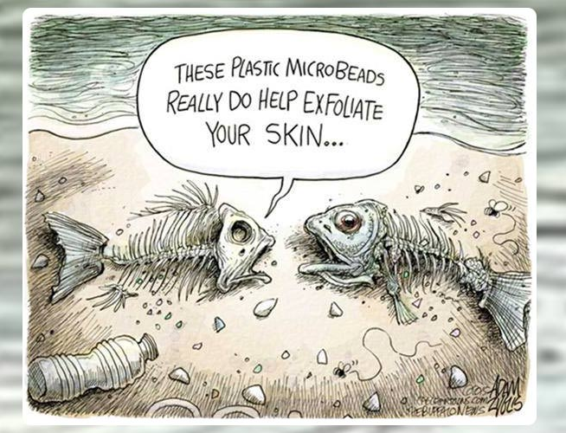
Types of microplastics | Microbeads
Microbeads are intentionally manufactured in their “micro” size. In cosmetics, they are present in a variety of products for different purposes.
Ingredients to avoid:
Polyethylene
Polypropylene
Polyethylene terephthalate
Polymethyl methacrylate
Microbeads have replaced traditional sand in industrial sandblasting activities because of their durability.
Image: Adam Zyglis / The Buffalo News
Notes:
Microbeads are intentionally manufactured in their “micro” size. In cosmetics, they are present in a variety of products for different purposes. They can be used to create films, such as face masks, to aid deep cleansing and exfoliating, as tooth-whiteners in toothpaste and in deodorants to block pores. Many countries have or are making steps to ban microbeads in cosmetics, but there is still a way to go!
The main ingredients to avoid are: Polyethylene, polypropylene, polyethylene terephthalate and polymethyl methacrylate.
For more information see: www.beatthemicrobead.com campaign.
Microbeads have replaced traditional sand in industrial sandblasting activities because of their durability. Sandblasting can be used, for example, to clean ships. This results in microbeads entering waterways.

Slide 14
Types of microplastics | Microbeads
Sources for microplastics includes: paint, tyres, pellets, textiles, geotextiles, detergent capsules
42,000 tonnes of intentionally added microplastics are estimated to be released into the environment every year.
0.7 to 1.8 million tonnes unintentionally.
Source: IUCN , Primary Microplastics in the Oceans, 2017; EU Action against microplastics, 2023
Notes:
As we can see in this chart from the International Union for the Conservation of Nature, 28% of the primary microplastics (not including microplastic broken down from larger plastic) are from car tyres: today, many car tyres are made partially from synthetic rubber which is plastic. As they wear down, small fragments are detached and released into road run-off, eventually finding their way into rivers, lakes or the ocean.
City dust is made up of many sources of plastics from abrasion of objects such as shoe soles, artificial turfs, and building coatings and intentional pouring of detergents.
On the list you can also see road markings and marine coatings- for which acrylic paints are often used. Road markings can also be applied with thermoplastics, which are common in Europe.
Geotextiles are permeable, flexible fabrics mainly made of synthetic fibres, used primarily in road construction, erosion prevention and drainage. Use likely to increase due to the impact of climate change on infrastructure.
For entire document from which this visual is taken, see https://portals.iucn.org/library/sites/library/files/documents/2017-002.pdf
See also EU Action against Microplastics, October 2023. ISBN 978-92-68-08157-0 doi:10.2779/917472.

Slide 15
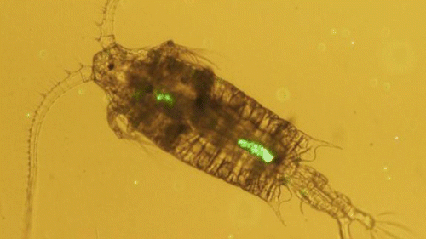
Impact of microplastics | Overview
Ingestion by animals
Changing properties of beaches
Vectors for harmful pathogens
Magnet for toxins
Notes:
Some studies suggest that the presence of microplastics in sand can alter the permeability (how easily water passes through) and temperature of the sand, which could have impacts on sea turtles which have temperature-dependent sex-determination e.g. Carson et al.(2011)
Microplastics can also act as vectors for harmful pathogens and invasive species which latch on and use the plastic as a floating raft. The smaller the plastic item, the larger the surface-area-to-volume ratio, allowing more microorganisms to attach to one piece of plastic. These floating rafts can then transport pathogens and invasive species to new geographic areas.
The properties of plastic make them so they act as magnets for toxins present in the marine environment, notably Persistent Organic Pollutants (POPs). These are pollutants present in run-off from agricultural fields, for example, which have difficultly breaking down in the marine environment. Studies have found that these pollutants can be present on and in microplastics at a concentration of 1 million times the background concentration in surrounding seawater.
This is also a problem when microplastics are ingested, as these toxins are carried into the bodies…. (see next slide)

Slide 16
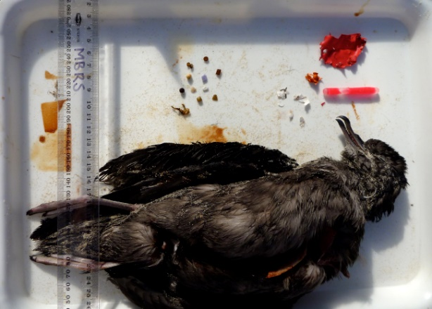
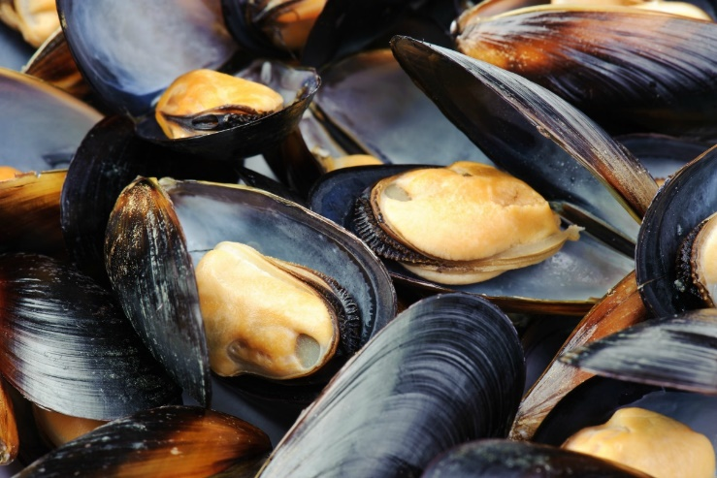
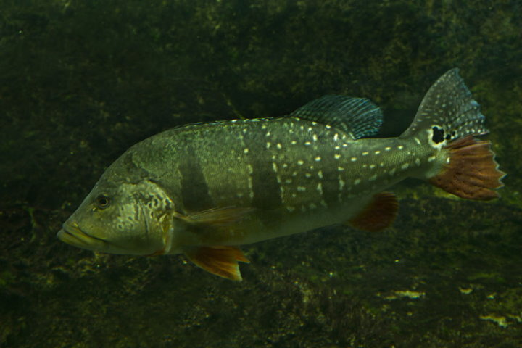
Impact of microplastics | Ingestion
Cole et al., (2013) : microplastic ingestion by zooplankon
Acampora et al. (2014) : stranded short-tailed shearwaters
De Witte et al., 2014; synthetic fibres found in mussels
Ribeiro-Brasil, et al. (2020): in 99% of Brazilian stream fish = human health
Notes:
Acampora et al. (2014) examined bodies of stranded short-tailed shearwaters for the presence of microplastics. More than 2/3 of birds in their study had ingested microplastics. Juveniles were more likely to ingest microplastics (e.g. rubber and balloons) than adults. Microplastics are being ingested by zooplankton. Zooplankton, such as the copepod pictured above, are at the very base of the marine foodweb. The earlier in the foodweb microplastics are ingested, the more severe the problem as toxins are concentrated each time an organism (which has already ingested microplastic) is ingested by another organism through a process called “bioaccumulation”.
It is likely that microplastics are making it all the way up the food chain to humans. Synthetic fibres have been discovered in the soft tissue of mussels on sale in supermarkets in Belgium (De Witte et al, 2014).Recently, scientists have found evidence of microplastics ingestion in almost 99% of 14 freshwater fish species in the eastern Brazilian Amazon (WWF, 2023).
The impact of plastic and associated toxins on biological organisms is a very active area of research, with some suggestions of impacts on the endocrine system (hormones) and interaction with DNA leading to cancer.
Ref
Alberghini, L., Truant, A., Santonicola, S., Colavita, G. & Giaccone, V. (2023). Microplastics in Fish and Fishery Products and Risks for Human Health: A Review. International Journal of Environmental Research and Public Health vol. 20. Preprint at https://doi. org/10.3390/ijerph20010789.
Ribeiro-Brasil, D.R.G. et al. (2020). Contamination of stream fish by plastic waste in the Brazilian Amazon. Environmental Pollution 266, 115241.

Slide 17
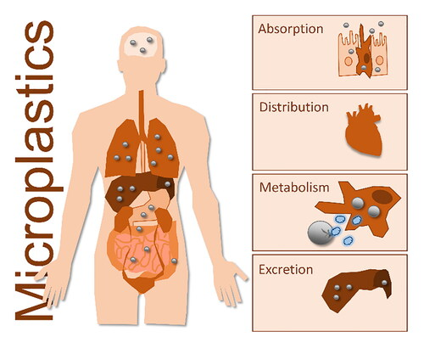
Impact of microplastics | Ingestion
WHAT ABOUT US?
Humans
Organs
Faeces
Transfer through the lungs into the blood
Transfer to babies in womb
Prata, 2023
Notes:
Microplastics found in organs and faeces. For example, in the placenta.
Can be moved through the body via a variety of processes. Those plastics – at least some – may be broken down to some extent by body processes. However, distribution can be extensive. How the body responds to these microplastics is still open for discussion and research.
References
Prata, J.C., 2023, Microplastics and human health: Integrating pharmacokinetics, Critical Reviews in Environmental Science and Technology, Volume 53 (16), 1489-1511

Slide 18
Impact of microplastics | Ingestion
WHAT ABOUT US?
It is estimated that up to 1 million lives lost / year where there is limited capacity to manage waste (Prata, 2023)
Microplastics in the body:
may damage the immune system
trigger inflammation
help carry toxins e.g. mercury or pesticides into the body.
Notes:
LMIC – Lower to Middle Income Countries
References
Prata, J.C., 2023, Microplastics and human health: Integrating pharmacokinetics, Critical Reviews in Environmental Science and Technology, Volume 53 (16), 1489-1511
WWF, 2023. Who pays for plastic pollution? Enabling Global Equity in the Plastic Value Chain. Towards a Treaty to end plastic pollution. Dalberg report. Switzerland.

Slide 19
Types of microplastics | Rubber
A significant % of plastics are made of rubber from road dust.
This is transported by stormwater which enters rivers / oceans (Werbowski et al., 2021)
Then taken up into the atmosphere.
In oceans, 28% - 78% microplastics are rubber.
Rubber granules or Tyre Wear Particles (TWP) contain a mixture of organic compounds and smaller particles leach more pollutants (Stack et al., 2023).
Notes:
Tyres are made of 24% synthetic rubber.
Tear Wear Particles may contain organic chemicals such as Polycyclic Aromatic Hydrocarbons, phthalates, benzothiazoles, bisphenols and heavy metals (Stack et al., 2023)
Ref
Stack, M.E., et al., 2023. Micron-size tire tread particles leach organic compounds at higher rates than centimeter-size particles: Compound identification and profile comparison. Environmental Pollution, 334, https://doi.org/10.1016/j.envpol.2023.122116.
Werbowski, L., et al., 2021. Urban Stormwater Runoff: A Major Pathway for Anthropogenic Particles, Black Rubbery Fragments, and Other Types of Microplastics to Urban Receiving Waters. ACS EST Water 2021, 1, 6, 1420–1428.

Slide 20
Microplastics in the atmosphere
Airborne microplastics
High altitude microplastics could influence cloud formation (Wang et al. 2023)- this might modify weather and lead to climate change.
Due to strong ultraviolet radiation these degrade faster in the upper atmosphere releasing greenhouse gases.
Notes:
Ref
Wang et al., 2023. Airborne hydrophilic microplastics in cloud water at high altitudes and their role in cloud formation. Environmental Chemistry Letters, 21, 3055-3062. DOI 10.1007/s10311-023-01626-x.

Slide 21
Microplastics | Conclusion
Microplastics affect cloud formation (Wang et al., 2023).
They degrade in our atmosphere adding greenhouse gases.
Plastic not degraded away falls to earth in our rain.
It falls on crops and onto our food, entering the food chain
It collects in the soil (Monkul and Ozhan, 2021; Paes et al., 2022), rivers (Russell, 2023), oceans (Emenike et al., 2022) and beaches.
Builds up in our environment much faster than it degrades.
Notes:
Brazilian mangrove soils have revealed extensive microplastic pollution, averaging 10,000 occurrences per kilogram of soil.
Ref
Emenike, P.C., et al., (2022). The effects of microplastics in oceans and marine environment on public health – a mini-review. IOP Conference Series: Earth and Environmental Science, 993, 012019.
Monkul, M.M. & Özhan, H.O. (2021). Microplastic Contamination in Soils: A Review from Geotechnical Engineering View. Polymers (Basel).
Paes, E. da S. et al. (2022). Widespread microplastic pollution in mangrove soils of Todos os Santos Bay, northern Brazil. Environ Res 210, 112952.

Slide 22
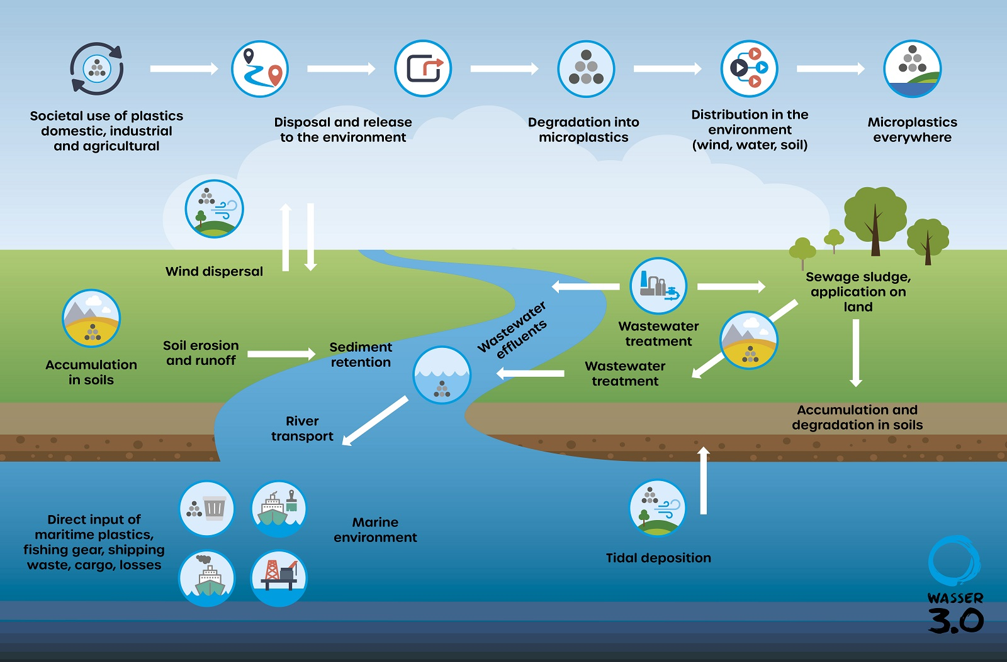
Notes:
Figure from:- https://wasserdreinull.de/en/knowledge/microplastics/?gclid=CjwKCAiAvJarBhA1EiwAGgZl0NGydVquJ8ucPSZPsyHuEZf5pGBwH3Agc1b-yZ1zwEebhIDPc5pAhhoC2h4QAvD_BwE

